Slide 1

Hearthbeat and Saturation level monitor
Marie-Estelle GOUNALANE
Indrajit RAJASOORIAR

Slide 2
01
03
Software side
Description of the project
Output
02
04
Component list
05
Problem faced & alternative solutions

Slide 3

Description of the project
Measure the heartbeat and the saturation level
Notify the user if the measurements are abnormal
1

Slide 4
Few definition…
Heartbeat : The number of time a human heart, beat per unit of time
Saturation oxygen : The level of oxygen that contains red cell before they get inside the lungs

Slide 5
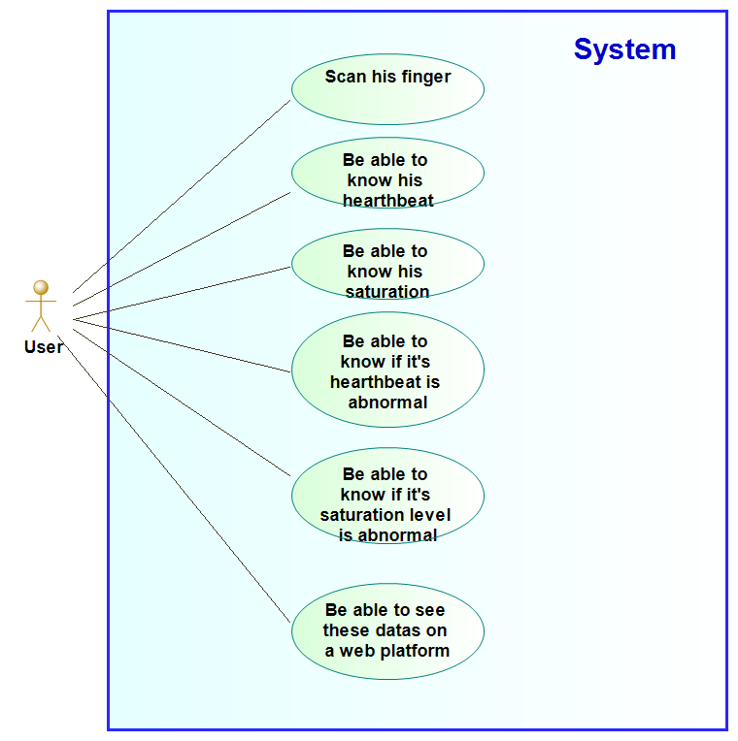
Use case diagram
2

Slide 6
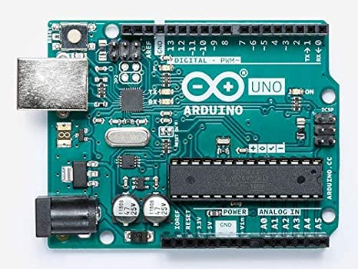
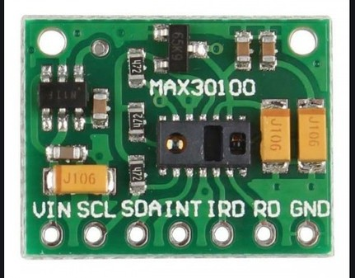
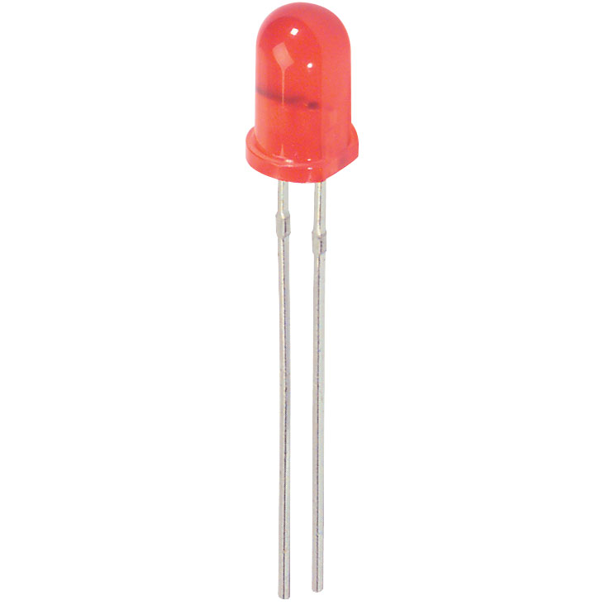


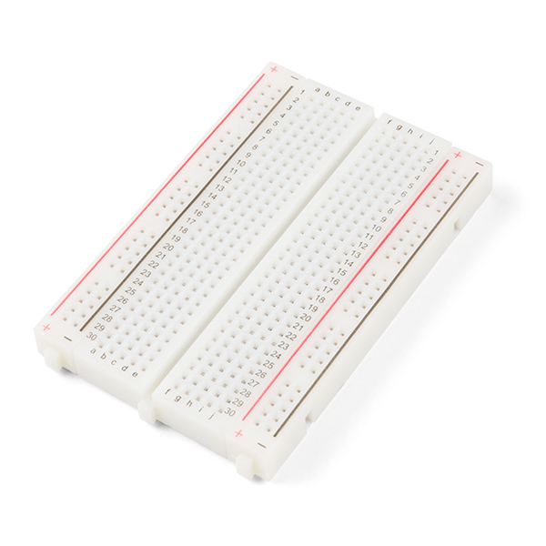

Component List
Arduino UNO
Max30100
2 LED
2 10 kOhm Resistance
10 Wires
Breadboard
USB Cable UNO R3
3

Slide 7


Software Side
Arduino IDE
Node Red
4

Slide 8

Problem we faced and alternative solution
Problem
Alternative Solution
5

Slide 9
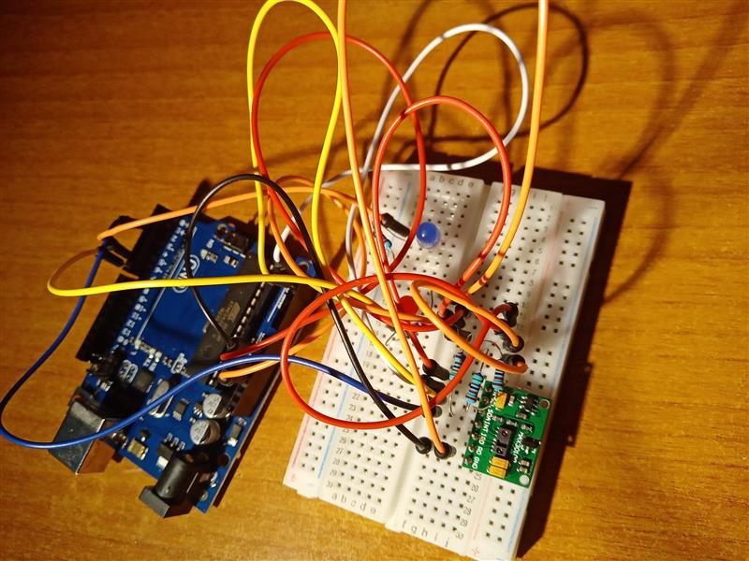
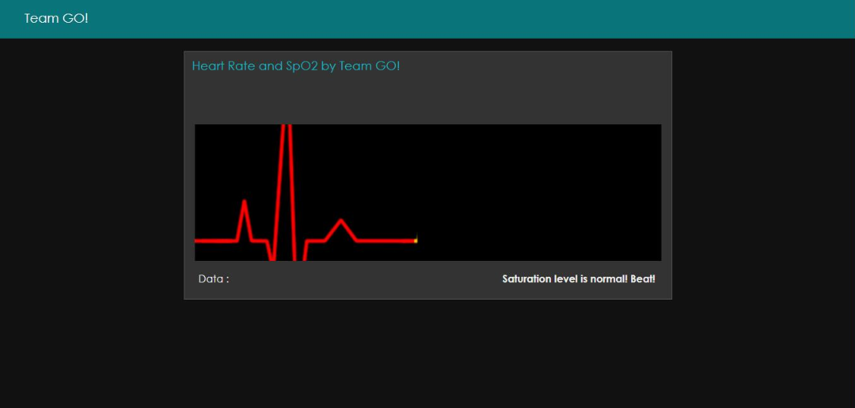
Output
6

Slide 10
About the device
Not precise
Delay between the time when the measurement is performed and the output
Takes time to stabilize
7

Slide 11
Contribution
Estelle : Assembly, Hardware, Arduino Code
Indrajit : Configuration Node Red, Design dashboard, Arduino Code
8

Slide 12
Conclusion
More precise measurement (age, weight….)
Cloud

Slide 13
Thanks!
Any questions ?

